Slide 1
One Stop Portal for Exporters
An Initiative
of Department of Commerce
Ministry of Commerce & Industry, Govt. of India
www.indiantradeportal.in
MAINTAINED & MANAGED BY
Federation of Indian Export Organisations

Slide 2
Use FTA’s & expand your Business
India has entered into trading agreements with various countries of the world with the objective of boosting its external trade
Partner countries exchange trade concessions (like allowing imports from partner country at lesser or zero duty).
Indian Exporters / Importers must understand how FTAs will impact business, create new export opportunities as well as put competitive pressures on domestic manufacturing sector.
FTAs are being signed by almost all countries and as per WTO statistics currently 398 FTAs are in force.

Slide 3
India’s FTA Partner Countries
India’s FTAs now have worldwide reach. Understand important aspects of each of the FTAs.
Already concluded
10 FTAs- 18 Countries
6 PTAs- 50 Countries
Duty Free Tariff concession for least developed countries-49 countries
10 Agreements under Negotiation/ expansion -32 Countries

Slide 4
Calculating Benefits / Cases
Export under FTA
Evaluate eligibility and calculate benefit
Detailed process steps
Cases of calculation of benefits specific products.
Rules of Origin
Rules of origin are important part of an FTA. Even if FTA offers Zero Duty imports facility to a product, benefit will be available only if it meets Rules of Origin Criteria.

Slide 5
FTA Essentials
Trade creation and Trade diversion
Import Duty, Policy
HS Classification
Custom Duty types, calculation
SPS and TBT provisions
Improved customs procedures
Use of correct HS code
Improved market access for commercial and professional services
Easier entry for Professionals
Better Investment Rules.

Slide 6
FTA Coverage
Trade in Goods & Trade Facilitation
Goods-Agriculture and Industrial products
Rules of Origin
Trade Remedies –Anti Dumping
Sanitary & Phytosanitary (SPS) and Technical Barriers to Trade (TBT)
More exports to FTA partner countries
Duty Free Imports of Inputs
More opportunities of investments in partner country

Slide 7
Exports under FTA & Benefits
Duty Reduction through FTA can create market access only if the partner country has non-zero MFN duty. When duty is already zero or very low for a particular item, FTA can not improve the market access.
Use the following steps to understand if a product meets eligibility criteria and exporting this product under FTA will save you some money.
Check if there is an FTA between your country and Destination country
Get the HS code of your product in destination country
Know MFN and FTA duty for your products in destination country
Compare MFN rate and FTA rate for each of the FTAs
Check if the product satisfies Rules of Origin
Comply with documentary requirements

Slide 8
Why access Indian Trade Portal?
Price is one of the important factors in exports and in many cases, The traditional components of determining proper pricing are costs, market demand, and competition. Each of these must be compared while accessing the foreign market.
If exporters are aware of such preferential agreement between exporting and importing nations, they can guide the buyers suitably so that increase in profit of buyer acts as an incentive for further augmenting exports from his country.

Slide 9
Continued 2
Indian Trade Portal provides such vital information helping the exporters to decide the tariff preference he enjoys other competitors. Similarly, he can look for most competitive source of imports for cheaper imports of raw materials and intermediate for competitive manufacturing and exports.
The exports benefits available for any product such as Duty Drawback, MEIS have also been provided at the portal so that Indian exporters can factor them to reduce his price to become further competitive in exports .

Slide 10
Features of the Indian Trade Portal
User-friendly Search
By product name
By ITC HS code
Mapping of Indian ITC-HS codes of other countries
Export Market Reports
2) MFN/Preferential Tariff –
Search and identify product, select the “Export” or “Import” button as per purpose and thereafter select upto five countries for export purposes.
List of Trade agreements entered with the countries get displayed against each country.

Slide 11
Rules of Origin
To avail the benefits of preferential tariff under a FTA products must qualify the condition specified in Rules of Origin of the FTA. If the product is not wholly Obtained or Produced in India then it must fulfill domestic Value addition and tariff classification transformation conditions.
To avail duty concession in the importing country, a foreign buyer requires Certificate of Origin from Competent authorities in India
Click on the Common Digital Platform of Certificate of Origin (Preferential) i.e. www.coo-dgft.gov.in Rules of Origin link as mentioned above for more details /clarification

Slide 12
Indian Trade Portal - Contents
MFN and preferential tariff for Indian products in 25 major markets comprising 87countries
All FTA partners including SAARC, ASEAN, MERCOSUR etc.
Other potential markets like Eurasian Economic Union (EEU), East African Community (EAC) and Gulf Cooperation Council (GCC) member states
Details of Rules of Origin (ROO)
More than 3500 non tariff measures [Sanitary and Phyto-Sanitary (SPS) Measures and Technical Barriers to Trade (TBT)] in top 25 markets & other 26Markets (Total 51)
Product wise Merchandise Exports from India Scheme (MEIS) & Duty Drawback rates
Products wise Export-Import policy of India
67 Export Market reports – Import statistics of the countries and India’s exports

Slide 13
For Indian Exporters
Inputs on basics to very technical operational matters
How to Start Exports, Export laws, procedures and know how
Frequently Asked Questions on Trade agreements, banking, Customs & Central Excise and export promotion schemes
Advise foreign buyers on the competitive tariff approach for easy market access
Free access to website and databases
Alerts on changes in tariffs and SPS & TBT measures
Provision for regular periodic updates

Slide 14
For Foreign Buyers
Database of around 80,000 Indian exporters from various industry sectors
EPCs have been advised to forward the databases of their members for listing on the portal with the objective to list maximum Indian exporters, provide wide options to buyers to select from
Information about Overseas Trade Fairs under MAI by the FIEO/ EPCs etc.
Business tool to search Product-wise/ITC-HS code-wise, select and send trade queries
Identify the best tariff option amongst MFN, multilateral or bilateral Agreement to import from India at competitive rates

Slide 15
Resources
The Indian Trade Portal also lists/hyperlinks the following important resources:
Export Promotion Bodies of India
International Trade Bodies
Directorate General of Foreign Trade
CBIC /icegate
Customs Duty Calculator
Rules, Regulation & Acts
Make in India
Alerts on the updates on portal – Tariff, SPS/TBT matters, Export-Import policy conditions of India, GST, MEIS, Duty Drawback, Interest Equalisation Scheme, Transport and Marketing Assistance (TMA), Rebate of State and Central Taxes and Levies (RoSCTL) Rates:

Slide 16
Accessing the Portal- 4 Easy steps For Exporters & Importers
Search Product Description
Select ITC HS code
Select Country of interest for Export or Import
Select corresponding ITC HS code of the importing country
Most Favored Nation tariff or Basic Customs Duty
Preferential Tariff
Rules of Origin
Non –Tariff Measures
(SPS & TBT)
MEIS & Drawback Rates
Export –Import policy of India

Slide 17
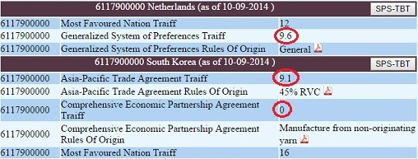
Tariffs and Preferential Tariffs
Countries without FTAs-
Product wise
MFN tariff
GSP benefits
NTMs
Countries with FTAs-
Product wise
MFN tariff
Preferential tariff
Preferential RoO
NTMs
6117900000 - Parts of garments or clothing accessories, knitted or crocheted

Slide 18
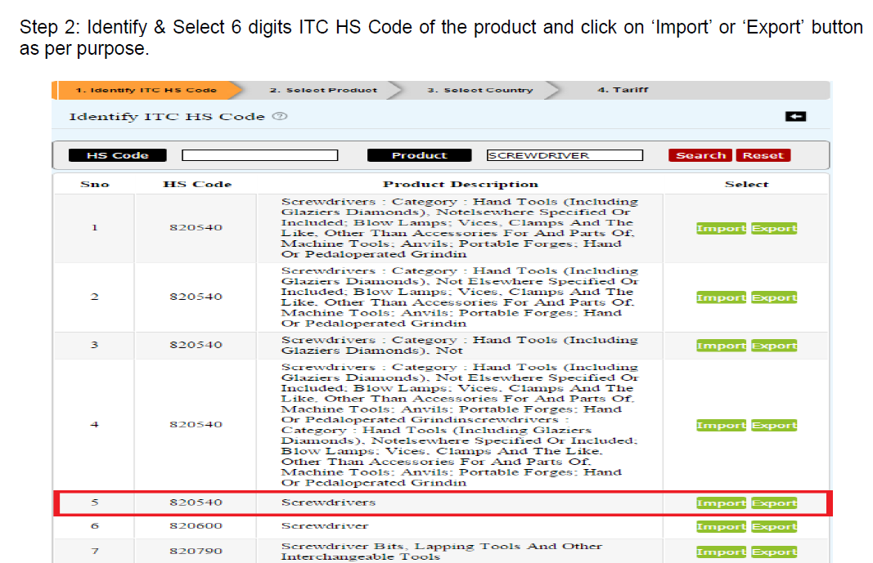

Slide 19
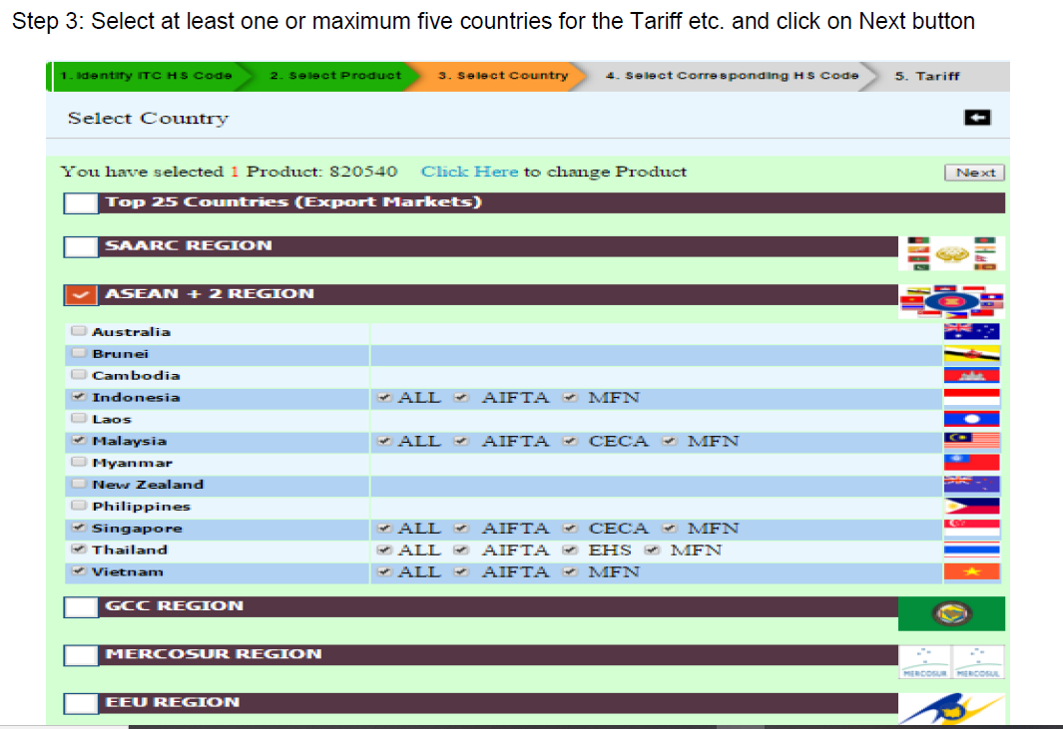

Slide 20
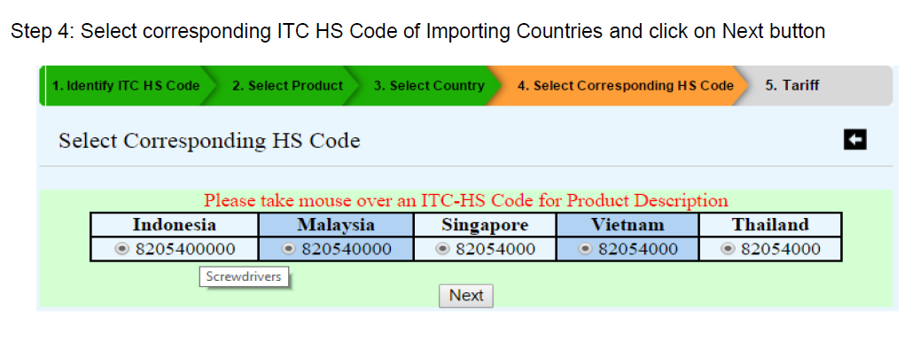

Slide 21
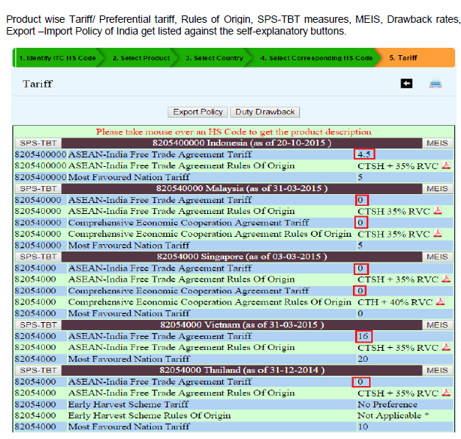

Slide 22
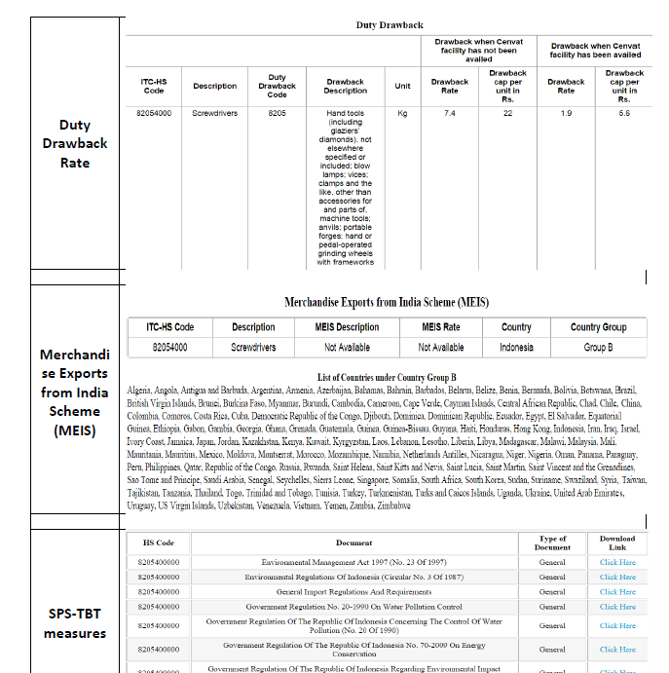

Slide 23
Thank You Email: aloksrivastava@fieo.org Ph: 0512-2534824

